Slide 1
Artificial Intelligence
Unit 2
Notes:
1

Slide 2
Outline
Agent = Performance, Environment, Actions, Sensors (PEAS)
What makes an agent Rational?
What makes an agent Autonomous?
Types of Agents: Reflex, Internal-State, Goal-Directed, Utility-Directed (RIGU)
Properties of Environments: Observable, Deterministic, Episodic, Static, Continuous (ODESC)

Slide 3
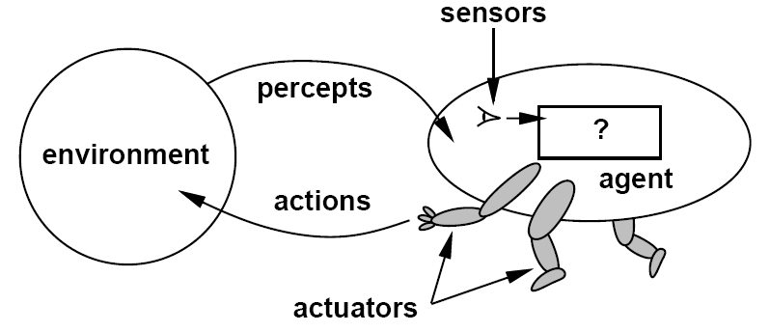
Agents
An agent is anything that can be viewed as perceiving its environment through sensors and acting upon that environment through actuators
sensations
Notes:
3

Slide 4

Example: Vacuum-Agent
Environment = tuple of variables:
Location, status of both rooms, e.g., E = { Loc=(A,B), Status=(Dirty, Clean) }
Action = variable drawn from a set: A= { Left, Right, Suck, NoOp }
Sensors = tuple of variables:
Location, and status of Current Room Only e.g., S = { Loc=A, Status = Dirty }
Notes:
4

Slide 5
function Vacuum-Agent([location,status]) returns an action
if Loc=A
if Status=Dirty then return Suck
else if I have never visited B then return Right
else return NoOp
else
if Status=Dirty then return Suck
else if I have never visited A then return Left
else return NoOp

Slide 6
Specifying the task environment
PEAS: Performance, Environment, Actions, Sensors
P: a function the agent is maximizing (or minimizing)
Assumed given
E: a formal representation for world states
For concreteness, a tuple (var₁=val₁, var₂=val₂, … ,var_{n}=val_{n})
A: actions that change the state according to a transition model
Given a state and action, what is the successor state (or distribution over successor states)?
S: observations that allow the agent to infer the world state
Often come in very different form than the state itself
E.g., in tracking, observations may be pixels and state variables 3D coordinates
Notes:
6

Slide 7
PEAS Example: Autonomous taxi
Performance measure
Environment
Actuators?
Sensors?
Notes:
7

Slide 8
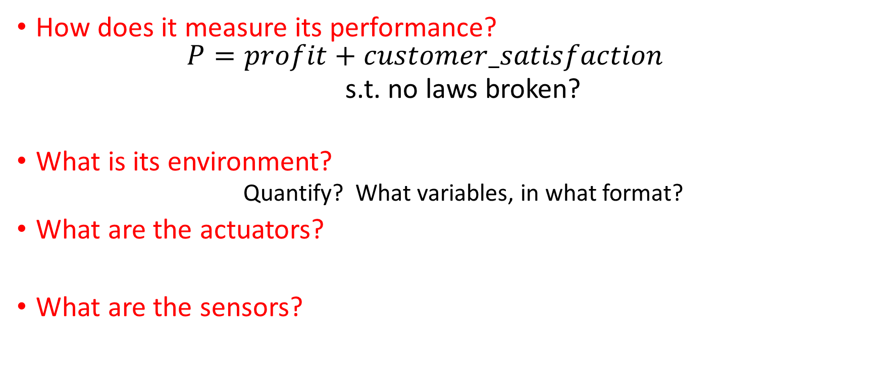
PEAS Example: Autonomous taxi
Notes:
8

Slide 9
Another PEAS example: Spam filter
Performance measure
Environment
Actuators?
Sensors?
Notes:
9

Slide 10
Another PEAS example: Spam filter
Performance measure
Is a false accept as expensive as a false reject?
Performance per e-mail, or in aggregate?
Environment
User’s e-mail account? Server hosting thousands of users?
Actuators?
Sensors?
Notes:
10

Slide 11
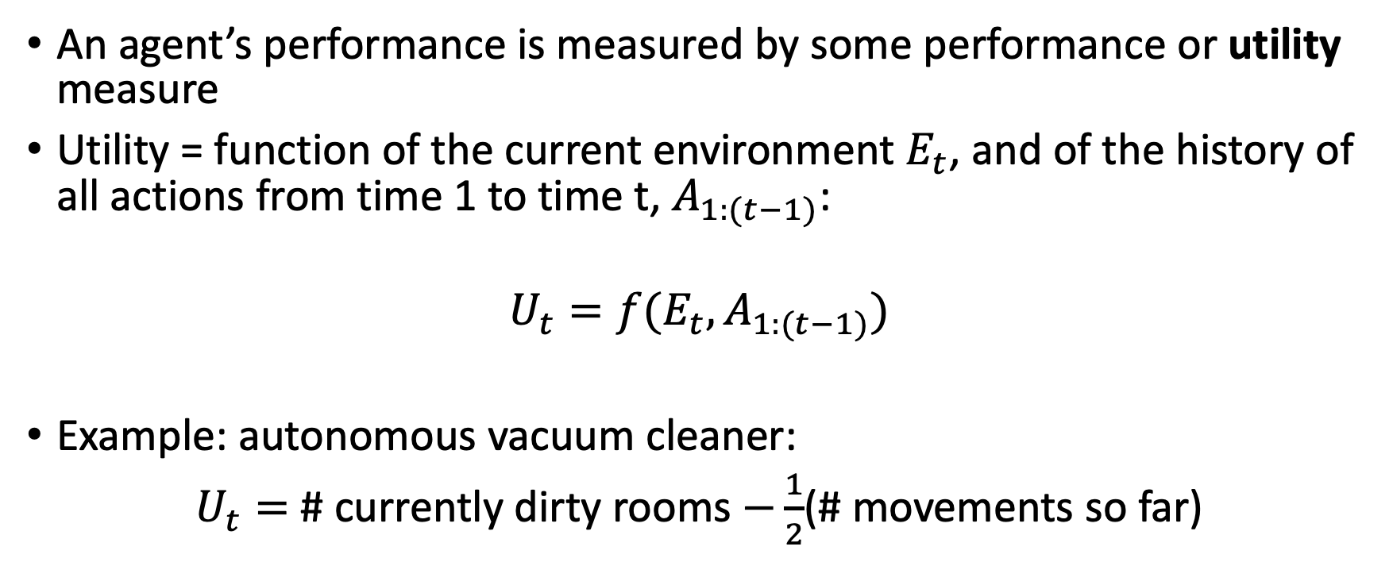
Performance Measure

Slide 12
What makes an agent Rational?
RATIONAL AGENT is one with RATIONAL BEHAVIOR: For each possible percept sequence, a rational agent should select an action that is expected to maximize its performance measure, given the evidence provided by the percept sequence and the agent’s built-in knowledge
RATIONAL THOUGHT: all of the above, + agent calculates and maximizes the performance measures in its own brain.
Performance measure (utility function): An objective criterion for success of an agent's behavior
Example Exam Problems:
Can a rational agent make mistakes?
Does rational behavior require rational thought?
Notes:
ExpectedUtility(action) = sum_outcomes Utility(outcome) * P(outcome|action)
12

Slide 13
Back to the Vacuum-Agent
function Vacuum-Agent([location,status]) returns an action
if Loc=A
if Status=Dirty then return Suck
else if I have never visited B then return Right
else return NoOp
else
if Status=Dirty then return Suck
else if never visited A then Left
else return NoOp
Example Exam Problem: Is this agent Rational?
Notes:
13

Slide 14
What makes an agent Autonomous?
Russell & Norvig: “A system is autonomous to the extent that its behavior is determined by its own experience.”
A Rational Agent might not be Autonomous, if its designer was capable of foreseeing the maximum-utility action for every environment.
Example: Vacuum-Agent
Notes:
ExpectedUtility(action) = sum_outcomes Utility(outcome) * P(outcome|action)
14

Slide 15
Types of Agents
Reflex agent: no concept of past, future, or value
Might still be Rational, if the environment is known to the designer with sufficient detail
Internal-State agent: knows about the past
Goal-Directed agent: knows about the past and future
Utility-Directed agent: knows about past, future, and value

Slide 16
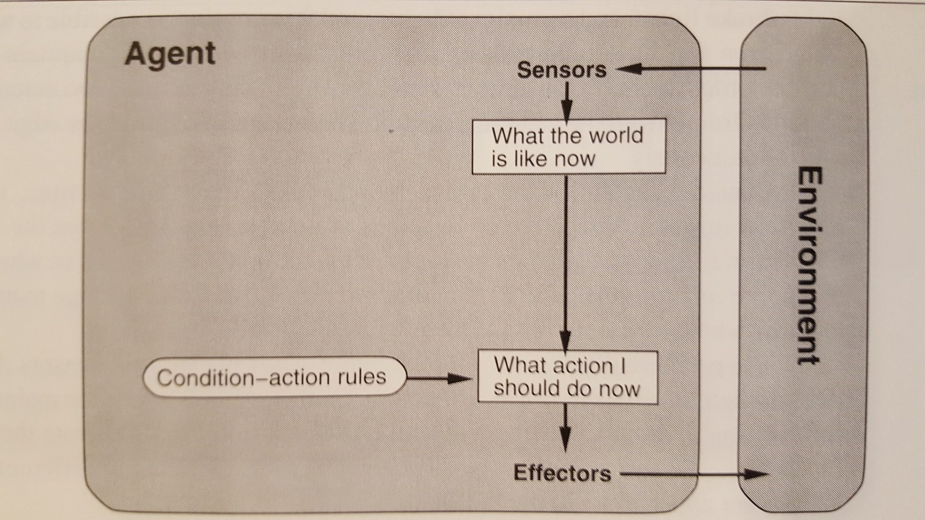
Reflex Agent

Slide 17
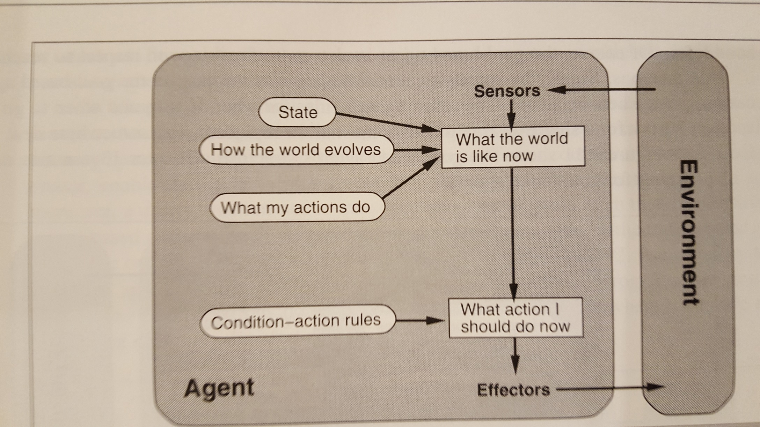
Internal-State Agent

Slide 18
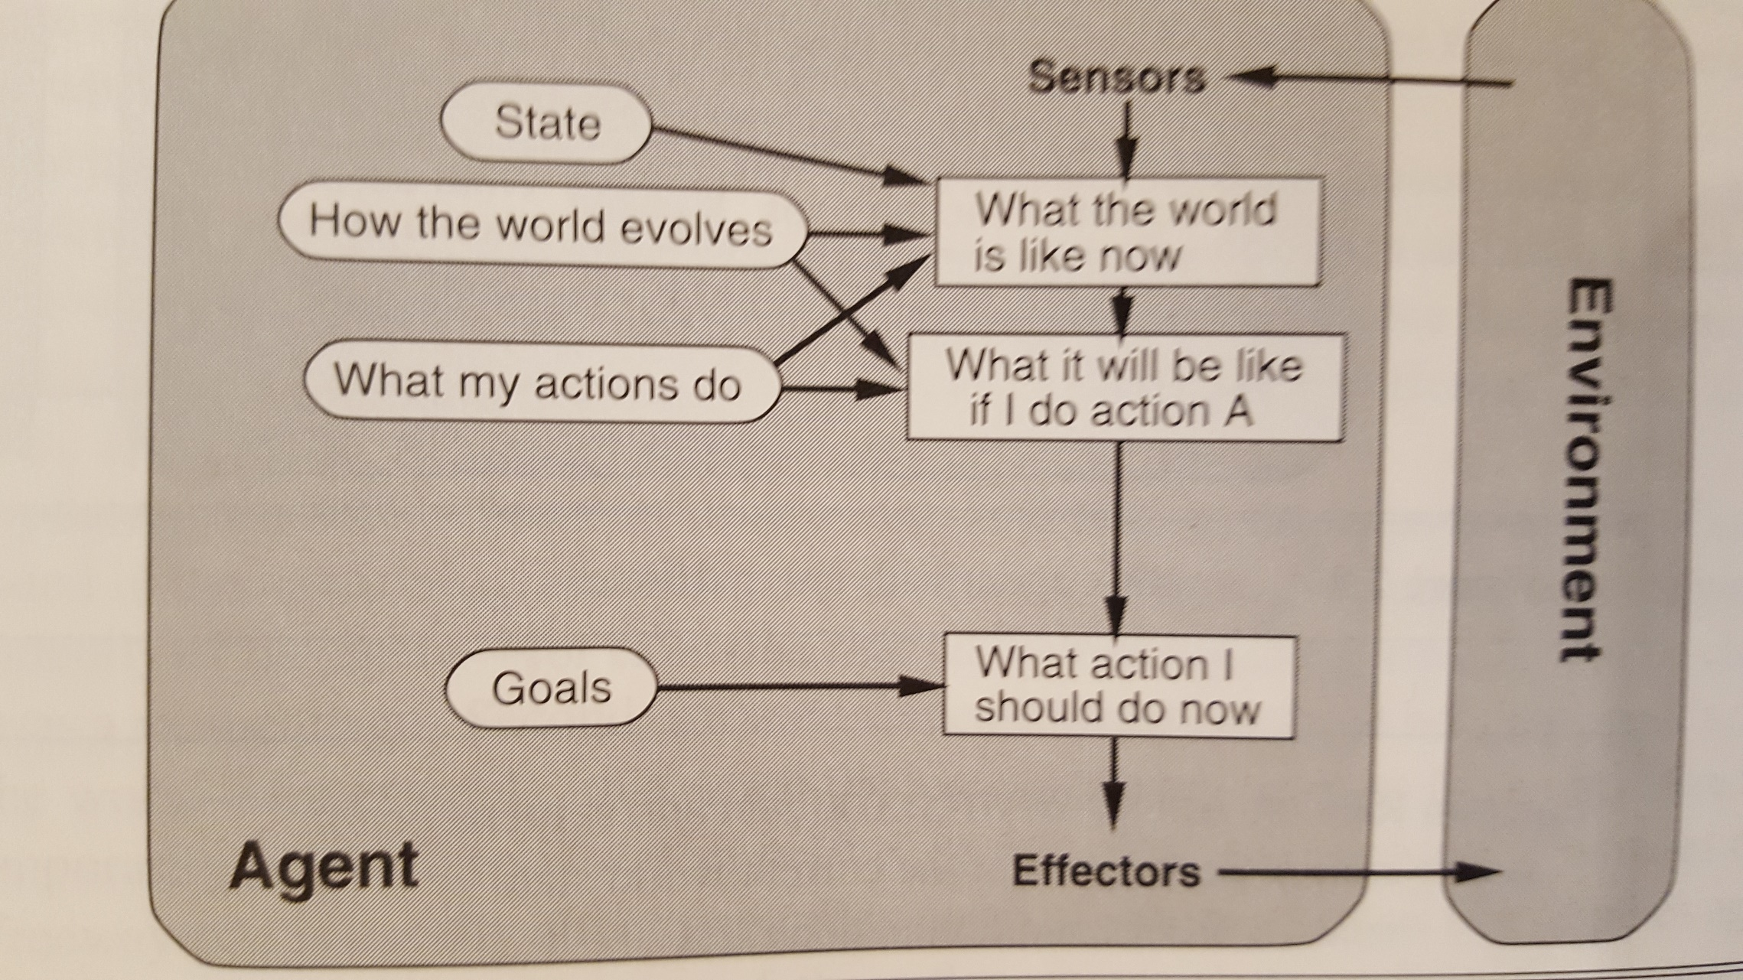
Goal-Directed Agent

Slide 19
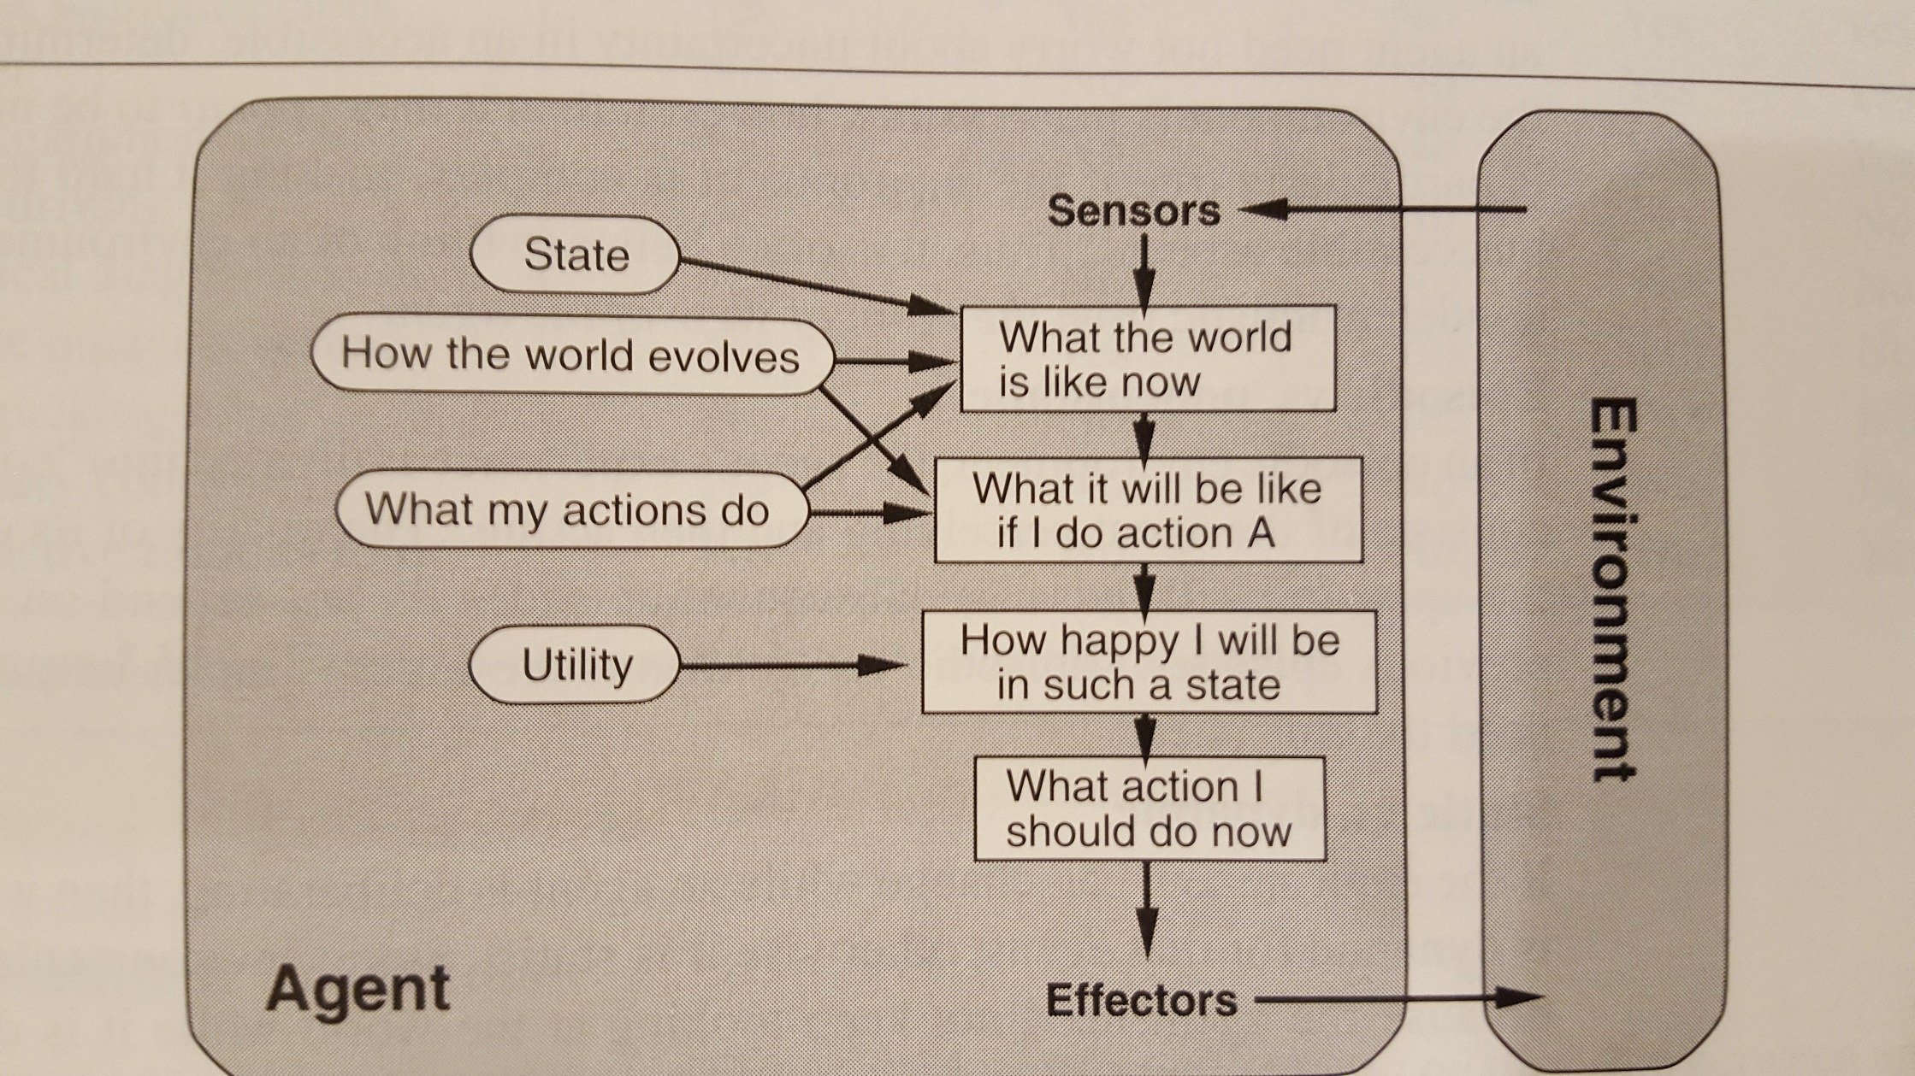
Utility-Directed Agent

Slide 20
PEAS
Performance measure: Determined by the system designer, attempts to measure some intuitive description of behavior goodness.
Actions: Determined by the system designer, usually trades off cost versus utility
Sensors: Determined by the system designer, usually trades off cost versus utility
Environment: Completely out of the control of the system designer.

Slide 21
Properties of Environments
Fully observable vs. partially observable
Deterministic vs. stochastic
Episodic vs. sequential
Static vs. dynamic
Discrete vs. continuous
Single agent vs. multi-agent
Known vs. unknown
Notes:
21

Slide 22
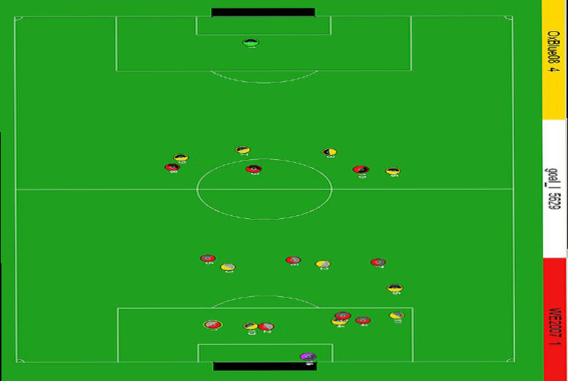
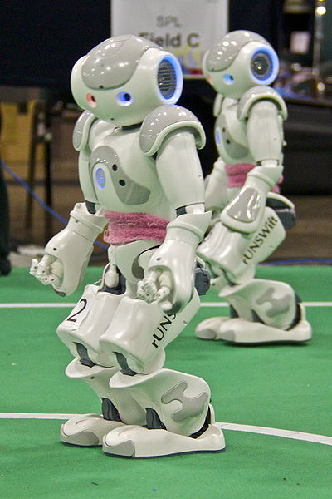
Fully observable vs. partially observable
Do the agent's sensors give it access to the complete state of the environment?
For any given world state, are the values of all the variables known to the agent?
vs.
Source: L. Zettlemoyer

Slide 23
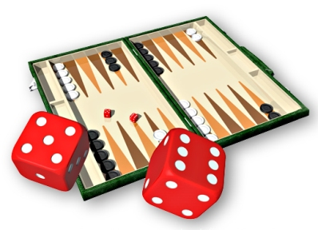
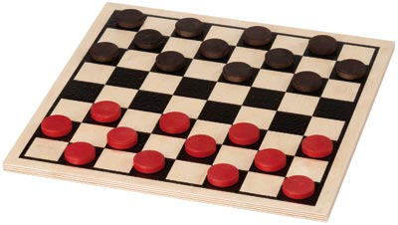
Deterministic vs. stochastic
Is the next state of the environment completely determined by the current state and the agent’s action?
Is the transition model deterministic (unique successor state given current state and action) or stochastic (distribution over successor states given current state and action)?
strategic: the environment is deterministic except for the actions of other agents
vs.

Slide 24
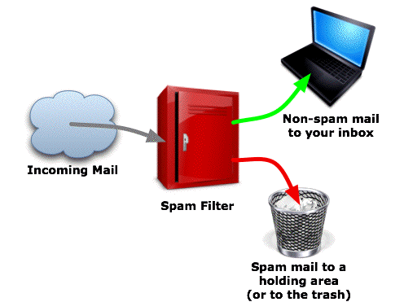
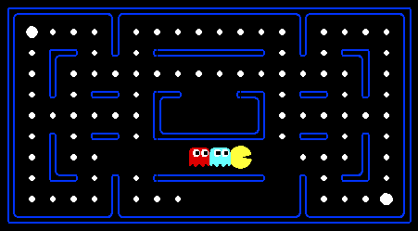
Episodic vs. sequential
Is the agent’s experience divided into unconnected episodes, or is it a coherent sequence of observations and actions?
Does each problem instance involve just one action or a series of actions that change the world state according to the transition model?
vs.
Notes:
Episodic: The agent's experience is divided into atomic “episodes,” and the choice of action in each episode depends only on the episode itself
24

Slide 25
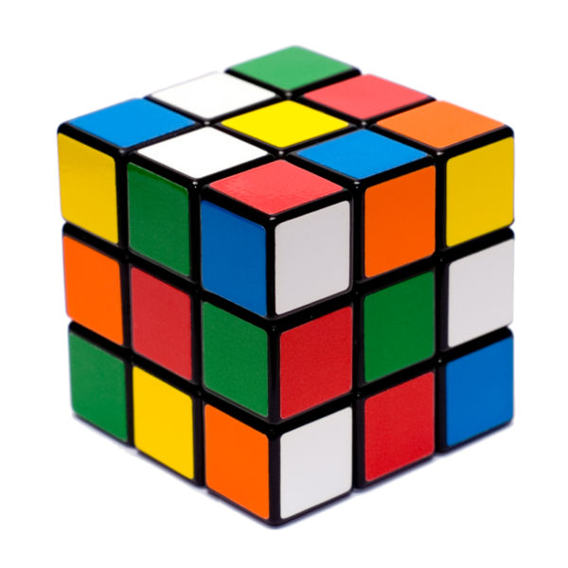
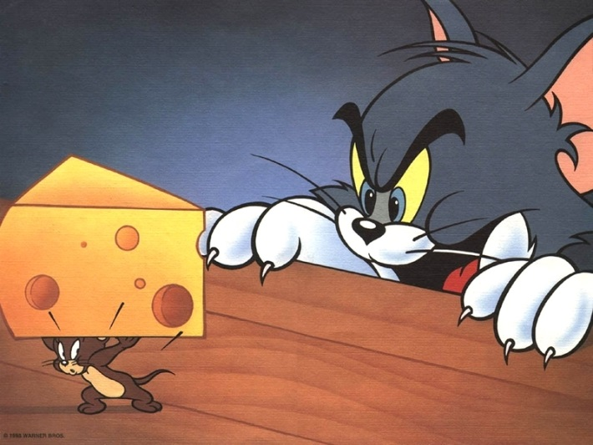
Static vs. dynamic
Is the world changing while the agent is thinking?
Semidynamic: the environment does not change with the passage of time, but the agent's performance score does
vs.
Notes:
25

Slide 26
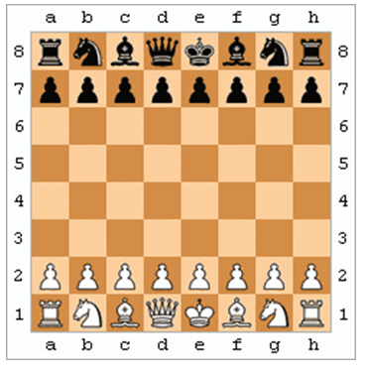
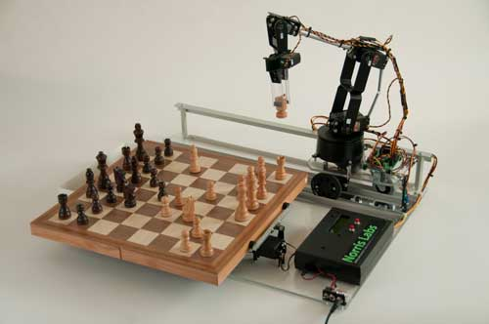
Discrete vs. continuous
Does the environment provide a countable (discrete) or uncountably infinite (continuous) number of distinct percepts, actions, and environment states?
Are the values of the state variables discrete or continuous?
Time can also evolve in a discrete or continuous fashion
“Distinct” = different values of utility
vs.
Notes:
26

Slide 27
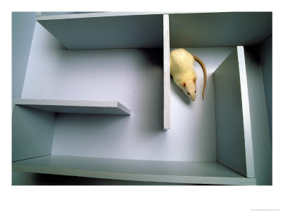
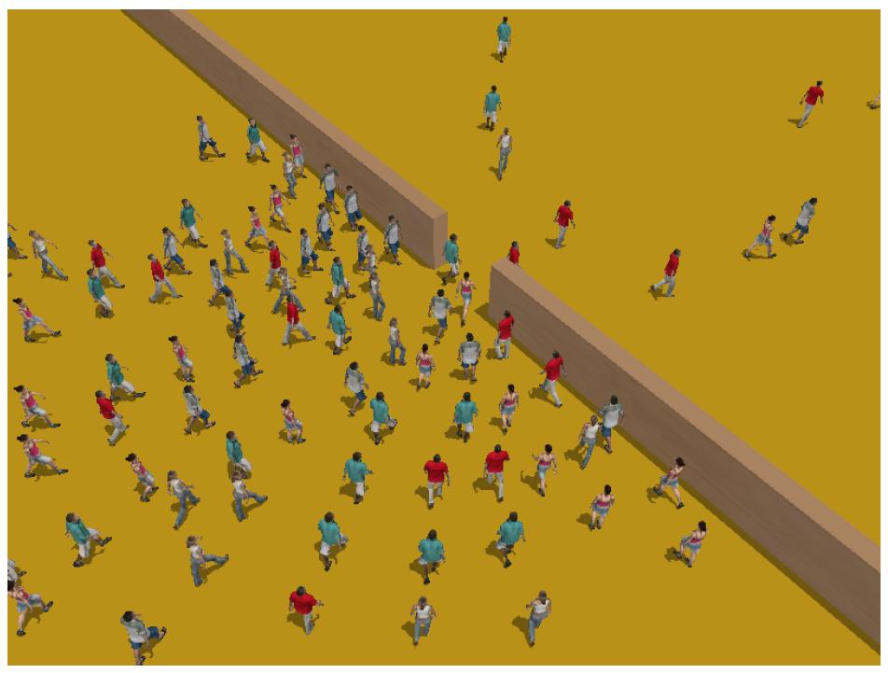
Single-agent vs. multiagent
Is an agent operating by itself in the environment?
vs.
Notes:
27

Slide 28
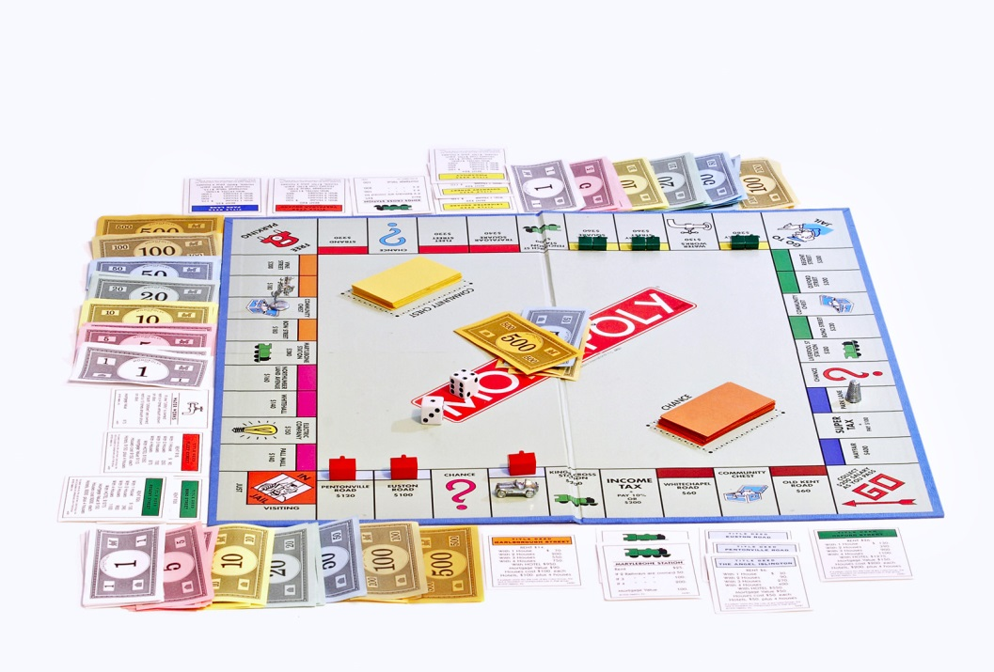
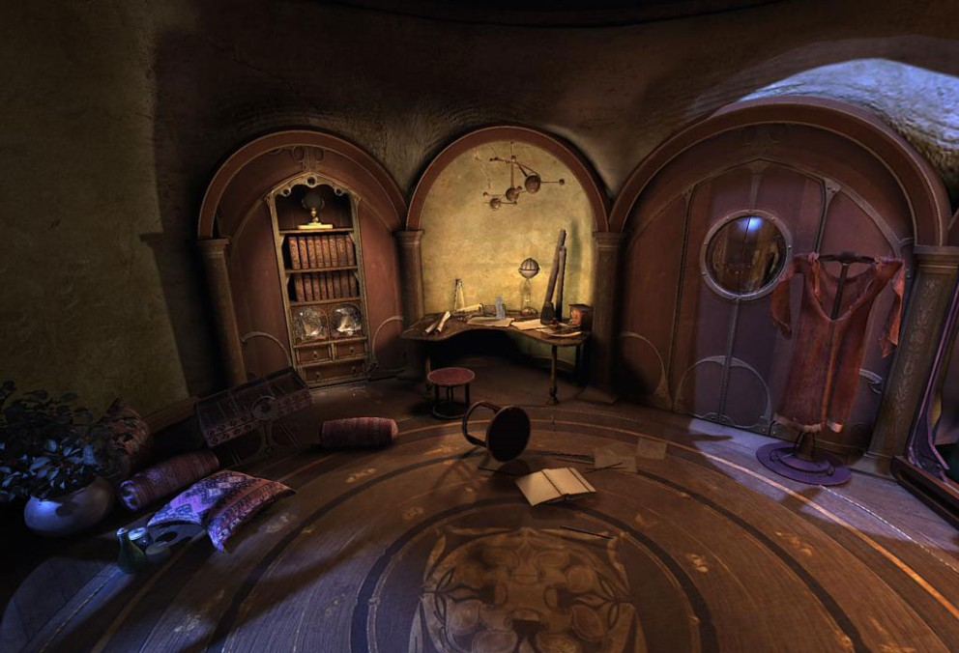
Known vs. unknown
Are the rules of the environment (transition model and rewards associated with states) known to the agent?
Strictly speaking, not a property of the environment, but of the agent’s state of knowledge
vs.
Notes:
28

Slide 29
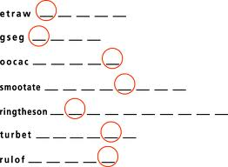
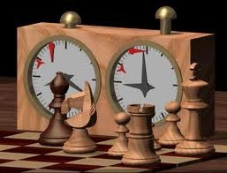
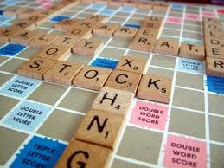
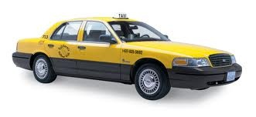
Examples of different environments
Word jumble solver
Chess with a clock
Scrabble
Autonomous driving
Observable
Deterministic
Episodic
Static
Discrete
Single agent
Notes:
29

Slide 30
Preview of the course
Deterministic environments: search, constraint satisfaction
Can be sequential or episodic
Strategic environments: minimax search, games
Might be either deterministic (e.g., chess) or stochastic (e.g., poker)
Might be fully observable (e.g., chess) or partially observable (e.g., battleship)
Stochastic environments
Episodic: Bayesian networks, pattern classifiers
Sequential, known: Markov decision processes
Sequential, unknown: reinforcement learning

Slide 31
Acknowledgements
Slides based on:
Pieter Abbeel and Dan Klein (UC Berkeley)
Mark Hasegawa-Johnson and Julia Hockenmaier (UIUC)
Tauhidul Alam (LSUS)

